Slide 1
Lecture 15 The Message Passing Interface
Prof. Brendan Kochunas
10/28/2019
NERS 590-004

Slide 2
Outline
Motivation and Big Picture
MPI Concepts
Point-to-Point Communication
Collective Communication
Overview of Advanced MPI features
One-Sided Communication
Hands on example (Hello World & Ping Pong)
Wednesday

Slide 3
Motivation & Big Picture

Slide 4
Motivation
For a variety of reasons, scientific computing platforms have evolved into the HPC architectures of today.
These machines allow scientists to complement theory and experiment with simulation and advance our understanding.
As we saw in the lecture 12 on Parallel programming models & algorithms, there are a variety of ways to think about how our algorithms can be implemented in parallel, but for them to be realized they must ultimately get implemented on a machine.
Why Message Passing?
The message passing model is (relative to other models) universal and may be realized on a variety of computer architectures.
The message passing model has been found to be a useful and complete model in which to express parallel algorithms. It places key elements of expressing the parallel algorithm in the hands of the programmer, not the compiler.
Message passing allows for good performance. Explicit management of data with processors allows compilers to be able to do the best job of fully utilizing memory hierarchy and processor

Slide 5
Learning Objectives
The fundamental concepts in MPI
How to do basic point-to-point communication
How to do collective communication
How to do one-sided communication
What are some of the advanced features offered, that may be useful for me in the future.

Slide 6
Source Material for this Lecture (aka Further Reading)
Gropp, W., Lusk, E. (2014). Using MPI: portable parallel programming with the Message-Passing-Interface. Third edition. Cambridge, Massachusetts: The MIT Press.
https://mirlyn.lib.umich.edu/Record/014888004
Gropp, W., Hoefler, T. (2014). Using advanced MPI: modern features of the Message-Passing-Interface. Cambridge, Massachusetts: The MIT Press.
https://mirlyn.lib.umich.edu/Record/013606199
The MPI Standard
https://www.mpi-forum.org/docs/

Slide 7
MPI Concepts & Basics

Slide 8







Message Passing Model
“Postal Analogy”
Model assumes different processes executing simultaneously (Living humans) have separate memory spaces (brains) and message passing is cooperative
(e.g. man sends letter, woman receives letter)
Process (Romeo)
Process (Juliet)

Slide 9

MPI Concepts: Messages
Sender
Receiver
Contents of message
For MPI, there’s also
messages need an identifier called a tag (I get lots of letters from you Romeo, which one are you talking about?!)
Type of message (e.g. letter, flowers, candy)
Size of message (e.g. 10 pages, a dozen roses, a box of chocolates)
Romeo
Juliet

Slide 10
MPI Concepts: Communicators
In postal analogy this would be like some notion of the post office/postal system
There is not a “good” analogy here.
Suggestion: think about it like an application programmer
How can MPI keep track of which unique processes are a part of your execution?
These must be named/identified in some way
What if your application uses a library built on MPI?
There should exist a reliable way to separate messages you implement from ones that the library implements.
Communicators solve the problem of organizing groups and contexts
Groups name processes
Contexts are like systems of post offices (think different countries, states, zip codes)
These facilitate the use of software libraries
Notes:
Draw communicators example

Slide 11
The Fundamental MPI Routines: Send/Recv
MPI_Send(variable_address, size, datatype, destination, tag, communicator)
MPI_Recv(variable_address, max_size, datatype, source, tag, communicator, status)
status: needed for knowing what happened (e.g. did it work?)
Notes:
Why a Tag?
Draw many messages from one process to another

Slide 12

MPI Program Basics (The original 6)
Routine
Purpose
MPI_Init Initialize MPI
MPI_Comm_size Find out how many processes there are
MPI_Comm_rank Find out which process I am
MPI_Send Send a message
MPI_Recv Receive a message
MPI_Finalize Terminate MPI

Slide 13
The MPI Library conventions
Naming convention:
Everything starts with MPI_
Compile time constants appear in all caps (e.g. MPI_COMM_WORLD)
Routines named as:
MPI_<Operation> (e.g. MPI_Send, MPI_Barrier, etc.)
MPI_<Class>_<action>_[<subset>] (e.g. MPI_Comm_size, MPI_Group_split, MPI_Comm_get_errhandler)
Fortran interfaces include extra ierr argument
C Interface ierr = MPI_<Class>_<action>(arg1,arg2,…,argN)
Fortran interface MPI_<class>_<action>(arg1,arg2,…,argN,ierr)

Slide 14
Compiling and Running MPI Programs
Compiling
Running
MPI installs with “compiler wrappers”
These are simple programs that call your normal compilers with the extra options for compiling and linking against the MPI library.
These are being standardized
mpiexec [options] <executable>
-np <number_of_processors>
-f <machinefile>
Try to avoid
mpirun (deprecated)
mpif77 and mpif90 (deprecated in OpenMPI)
mpiCC (some file systems are not case sensitive)
Wrapper | Compiler
mpicc | C
mpicxx, mpic++, mpiCC | C++
mpifort, mpif77, mpif90 | Fortran

Slide 15
Common MPI Distributions
MPICH (ANL/UIUC)
This is THE reference implementation, often supports newest features first. Very high quality.
Does not support infiniband networks
Basis for many other implementations
MVAPICH (OSU)
Derivative of MPICH supporting high speed networks
OpenMPI
Competitor with MPICH, has good process control, slower on feature support
Generally has more bugs than MPICH
Vendor implementations
Built on MPICH but swap routines/functions for code specific for their machines
Intel, HP, Cray, SGI, IBM, and probably others.

Slide 16
Point-to-Point Communication

Slide 17
MPI Point-to-Point Communication Routines
Point-to-Point communication involves 2 processors.
Basic calls:
Many variations (communication modes):
Standard mode – a send will not block even if a receive for that message has not occurred (except for lack of resources, e.g. out of buffer space at sender or receiver)
Buffered mode (MPI_Bsend) – same as standard mode, except return is always immediate, i.e., returns an error code as opposed to waiting for resources)
Synchronous mode (MPI_Ssend) – will only return when matching receive has started. No extra buffer copy needed, but can't do any computation while waiting.
Ready mode (MPI_Rsend) – will only work if matching receive is already waiting. Best performance, but can fail badly if not synchronized.
Immediate mode (MPI_Isend, etc.) – starts a standard-mode send but returns immediately. No extra buffer copy needed, but the sender should not modify any part of the send buffer until the send completes.
Also a combined sendrecv
MPI_Send(variable_address,
size,
datatype,
destination,
tag, communicator)
MPI_Recv(variable_address, max_size,
datatype,
source,
tag, communicator, status)
Notes:
Sample illustrations of each

Slide 18
MPI Point-to-point communication
So many choices, which one is best?
The standard send and recv are good for learning MPI, but are generally not used in production application codes.
Buffered send and recv require more effort on the part of the application programmer to manage the buffer.
Synchronous send and recv are often same as standard send and recv
Some form of non-blocking send and recv is often best for performance.
MPI_Isend and MPI_Irecv
Does require additional checking for completion
There are limits to the number of simultaneous messages

Slide 19
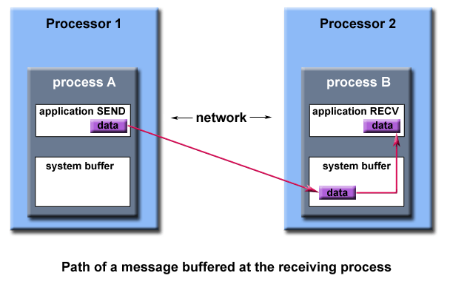
Message Buffers
An MPI implementation may (not the MPI standard) decide what happens to data in these types of cases.
Typically, a system buffer area is reserved to hold data in transit.
System buffer space is:
Opaque to the programmer and managed entirely by the MPI library
A finite resource that can be easy to exhaust
Often mysterious and not well documented
Able to exist on the sending side, the receiving side, or both
Something that may improve program performance because it allows send - receive operations to be asynchronous.

Slide 20
Collective Communication

Slide 21
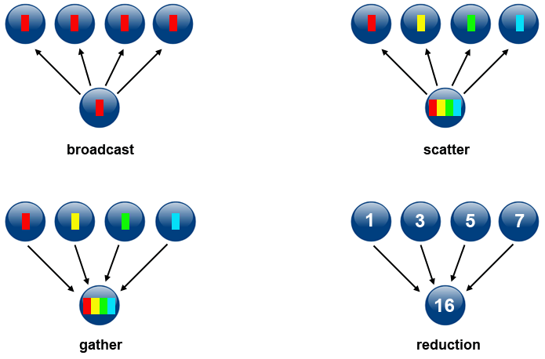
MPI Collectives (1)
These involve all MPI processes in a communicator
Collectives can always be implemented with point-to-point routines
But it is often better to use the routines provided by MPI
Common collective operations include:
Broadcast
Reduce
Scatter
Gather
Scan
Alltoall
Figure from: https://computing.llnl.gov/tutorials/parallel_comp/

Slide 22
MPI Collectives (2)
Notable Variations
Types of reduction operations
The “v” suffix
Stands for vector
Means the size of data may be different for different processors
Gatherv & Scatterv, Alltoallv
The “All” prefix
Means the result of the operation is the same for all processors in communicator
Allreduce & Allgather
Arithmetic
MPI_SUM
MPI_PROD
Relation Operators (Mins & Maxes)
MPI_MAX
MPI_MIN
MPI_MAXLOC
MPI_MINLOC
Logical Operators
MPI_LAND
MPI_LOR
MPI_LXOR
Bit-wise operators also supported

Slide 23
Example: MPI_Allreduce Algorithm
Reduce + broadcast
Reduce performed sequentially
P-1 steps
Broadcast performed sequentially
Also P-1 steps
Total of 6 steps
1
4
9
16
16
16
16
3
3
3
3
16
16
16
5
5
5
5
5
16
16
7
7
7
7
7
7
16

Slide 24
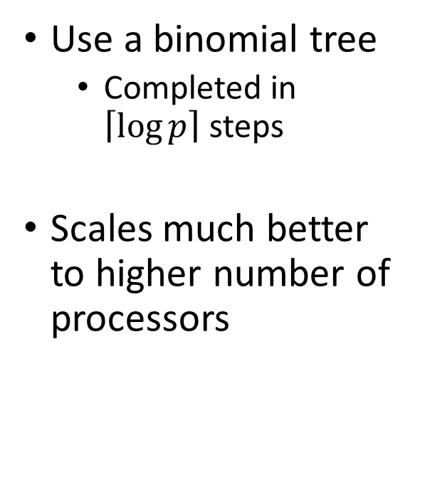
Example:Better Allreduce
Use a binomial tree
Completed in $\left\lceil \log{p}\right\rceil$ steps
Scales much better to higher number of processors
1
4
16
3
4
16
5
12
16
7
12
16

Slide 25
Even More Advanced Allreduce
What about long messages?
Reduce_scatter + Allgather
Different algorithms perform better under certain conditions
Source: http://www.mcs.anl.gov/~thakur/papers/ijhpca-coll.pdf

Slide 26
Summary of Collectives
Provided as a convenience to the programmer
Collectives perform “common” operations that arise in programming
Often implemented with more complex and higher performing algorithms
Than what a beginner would implement.
They represent a synchronization point in the program
Always, always, always involves all processors within communicator
Otherwise, it causes a deadlock

